Slide 1


The IT education system in Hungary
How it is now vs. how it should be

Slide 2

Expectations, hopes
Research method
Research results
Thoughts
Questions
STRUCTURE

Slide 3

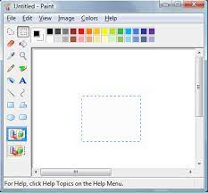



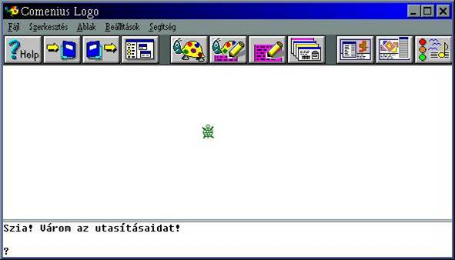
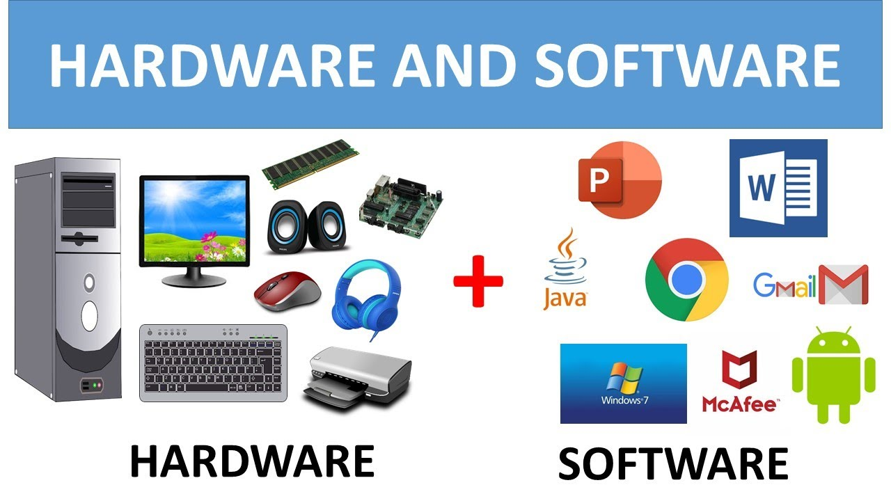

Expectations

Slide 4

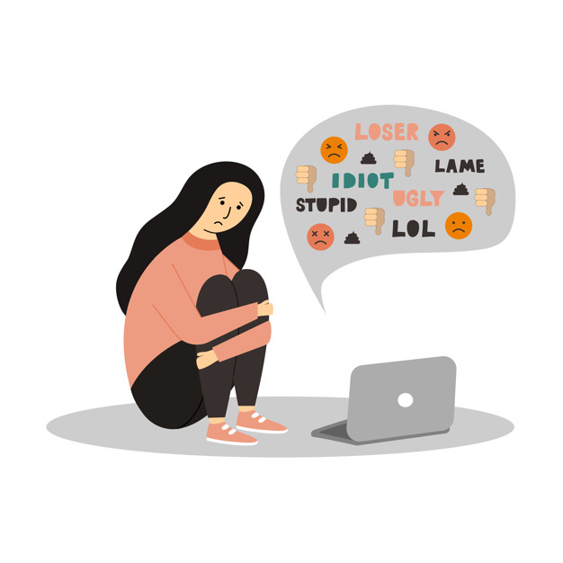


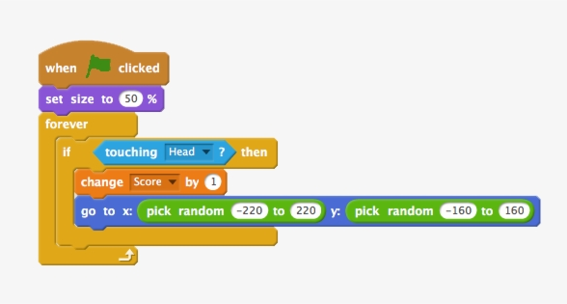
Hopes

Slide 5

Research method
What is expected by the government
What are they actually studying

Slide 6
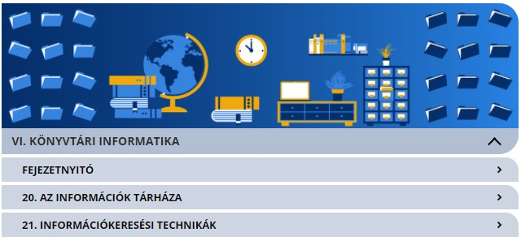
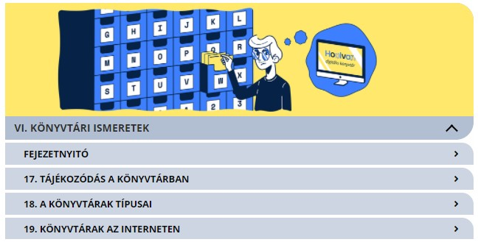
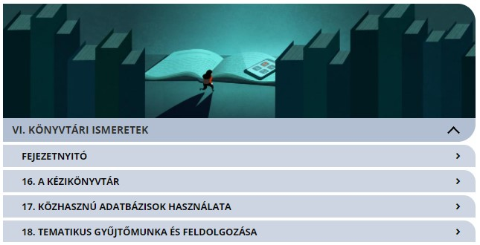
Available time per topic
6th GRADE
7th GRADE
8th GRADE
Weeks in a school-year = 35 | Length of a class = 45 minutes | IT classes per week = 1
Category-closing tests = 6
35 – 6 = 29 Classes to study
29*45 = 1305 Minutes to study
1305/21 = 62 Minutes per topic
35 – 6 = 29 Classes to study
29*45 = 1305 Minutes to study
1305/19 = 68 Minutes per topic
35 – 6 = 29 Classes to study
29*45 = 1305 Minutes to study
1305/18 = 72 Minutes per topic
Average: 67 minutes per topic!

Slide 7
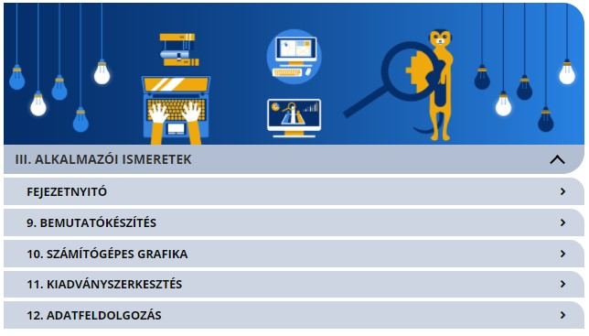
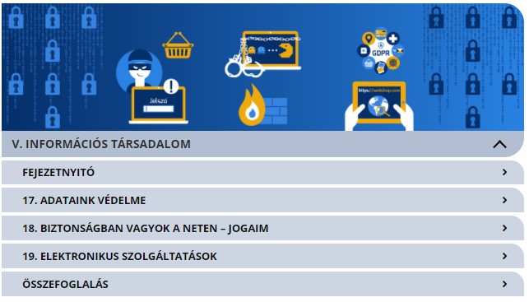
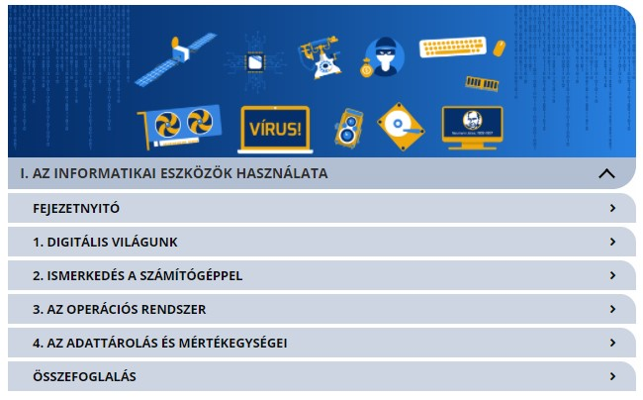
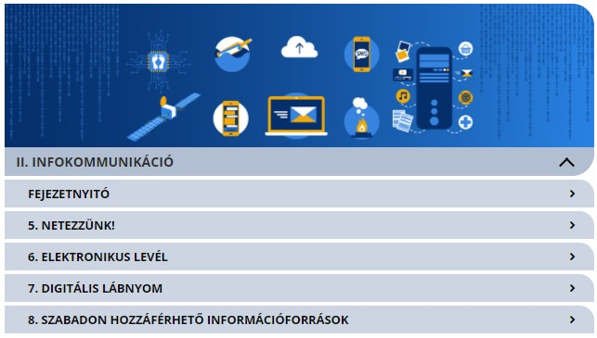
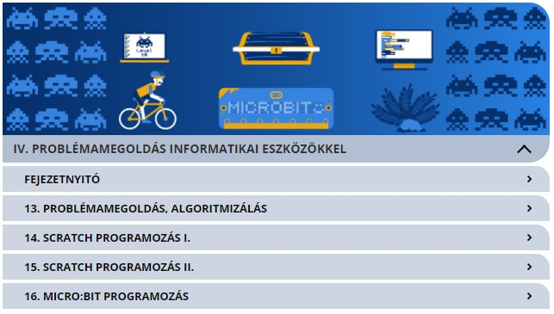
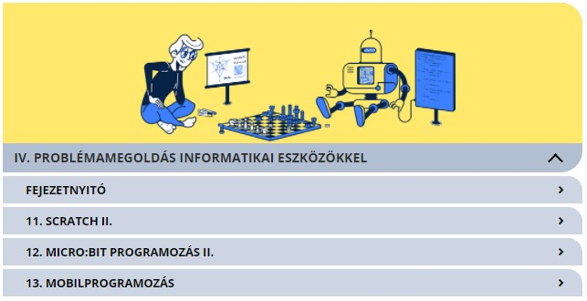
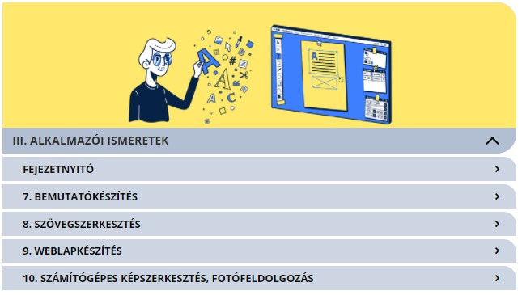
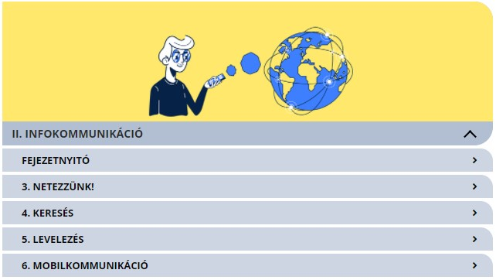
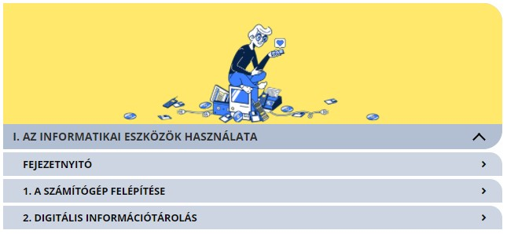
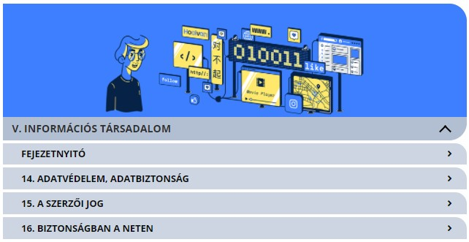
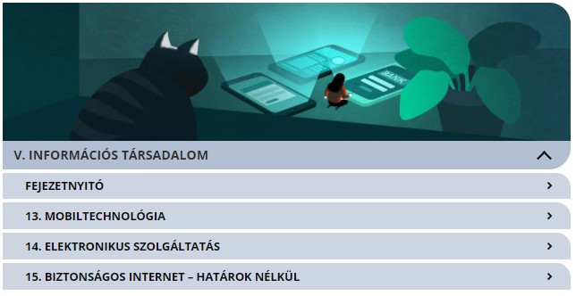
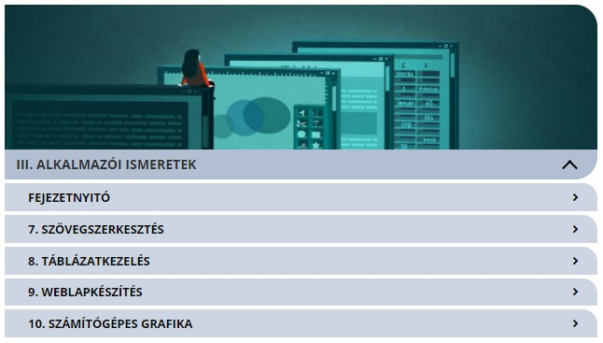
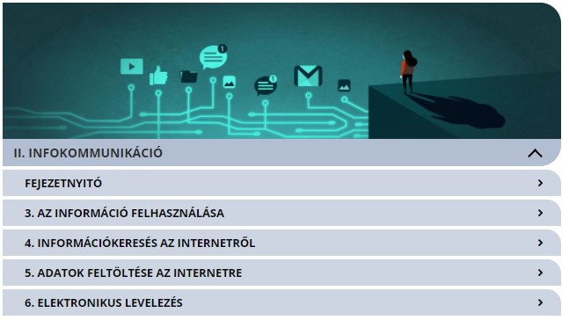
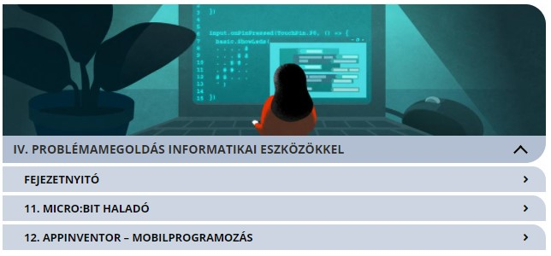
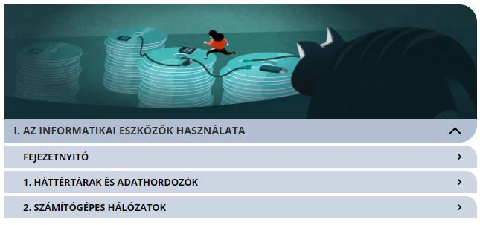
IT textbook Table of contents
6th GRADE (12-13years old)
The usage of IT appliances
Info-communication
User knowledges
Problem-solving with IT tools
IT society
Library knowledges
7th GRADE (13-14years old)
8th GRADE (15-16years old)

Slide 8

OMG…really??
“Weeeell, we really didn’t do too much on IT classes, especially during the pandemic…”
“Our teacher talked a bit about computers, but I didn’t understand it at all… after that we spent the whole year with MS word…oh, and at the end, we played around with “kvács” or what was it…oh, Scratch!”
“We studied a lot of definitions about computers, but then our teacher gave us Word exercises, and we had to do them”
“Our teacher expected us to go through the exercise books, and to do some exercises after each topic, but we didn’t really understood it, and she wouldn’t explain deeper…and at the special course, we used microbit as well”

Slide 9

Expectations & Hopes

Slide 10

Thank You!
QUESTIONS?

